Slide 2
2018-2019: New Standards, New Resources
North Carolina adopted new standards for English Language Arts and Math. These standards are vertically aligned and embrace essential instructional shifts.

Slide 3
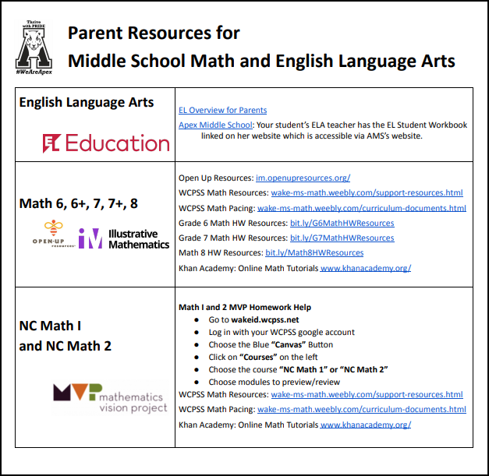
2018-2019: New Standards, New Resources

Slide 4
EL Education for
English Language Arts 6-8
What is EL Education?
EL Education is an acclaimed curriculum written by and for teachers with emphasis placed on active learning and student engagement. Classrooms are structured with highly collaborative activities that allow students to engage in academic conversations and investigations of rich academic topics. EL aims to contribute to a student’s ability to be globally competitive and active contributors in building a better world.

Slide 5
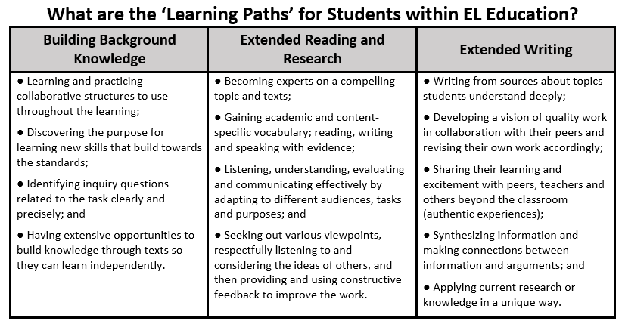
EL Education for
English Language Arts 6-8

Slide 6
EL Education for
English Language Arts 6-8
Student Resources for ELA
Students engage in four learning modules that are divided into three units.
Each module features books – not textbooks -- which have been carefully selected.
Students engage in a central text for use during their study of a module. These central texts are supported by a list of recommended texts—books, articles, and primary source documents—that balance literary and informational texts at appropriate levels of complexity.

Slide 7
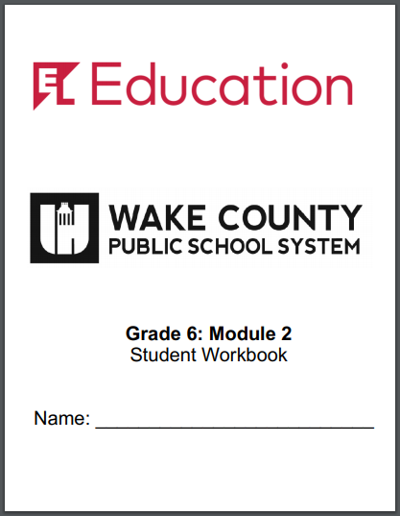
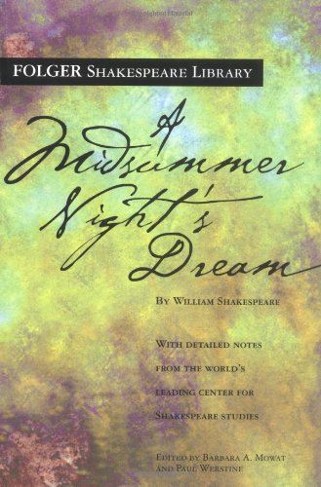
EL Education for
English Language Arts 6-8
What should families see at home?
Students will have homework assignments related to what they are reading at school. Often this homework will involve extensive writing.
They will independently read at home and engage families in conversations topics from school.

Slide 8
EL Education for
English Language Arts 6-8
Resources for Parents and Students
EL Overview for Parents
Apex Middle School: Your student’s ELA teacher has the EL Student Workbook linked on her website which is accessible via AMS’s website.

Slide 9
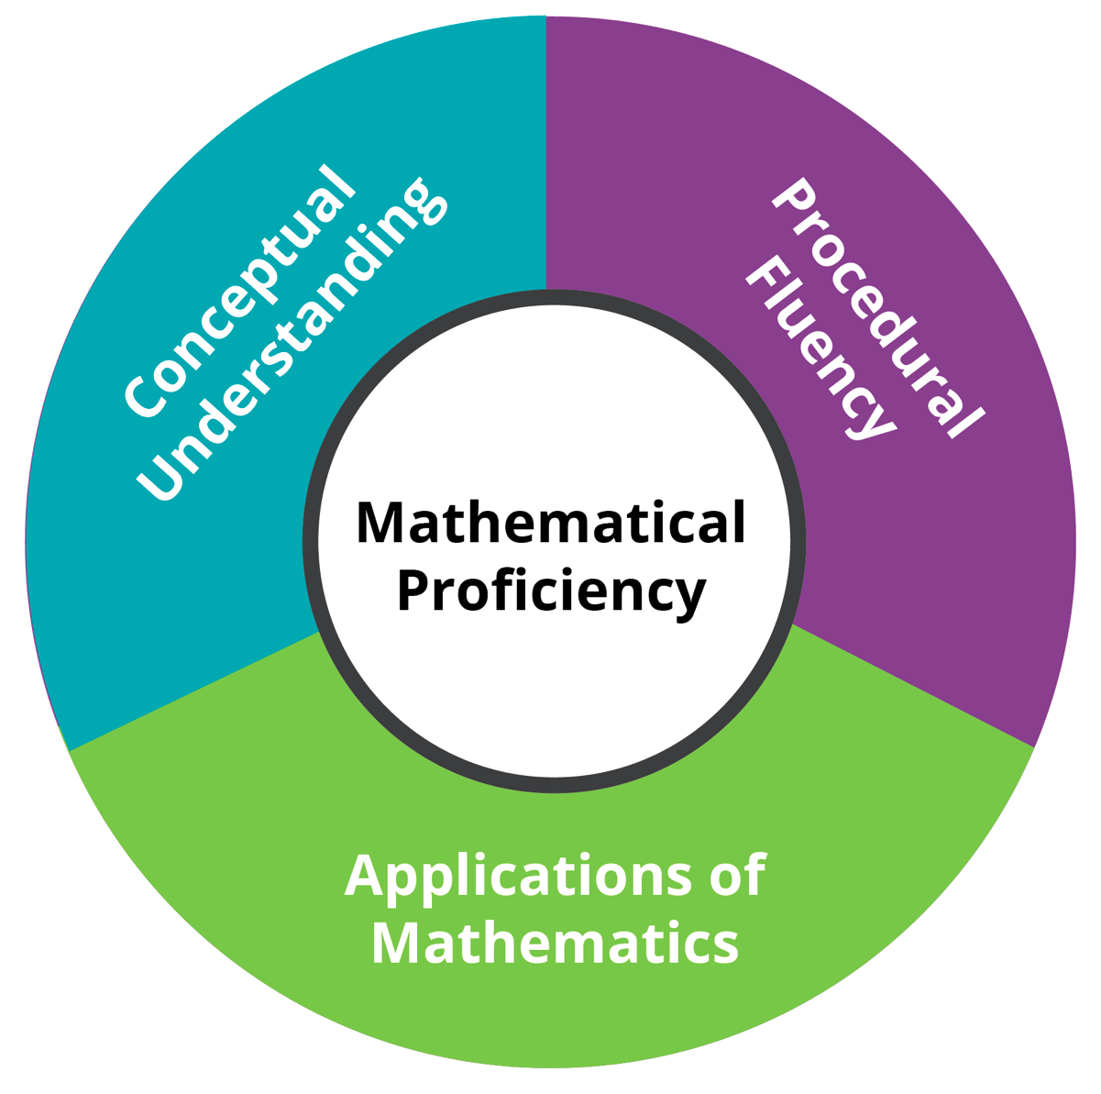
Open Up Resources (OUR) for Math 6, 6+, 7, 7+, 8
IM Vision:
A world where learners know, use, and enjoy mathematics.
Problem-Based Lesson Structure
Deep Conceptual Exploration
Standards-aligned Assessment
Math Content and Language Routines

Slide 10
Open Up Resources (OUR) for Math 6, 6+, 7, 7+, 8
Overarching Design Structure

Slide 11
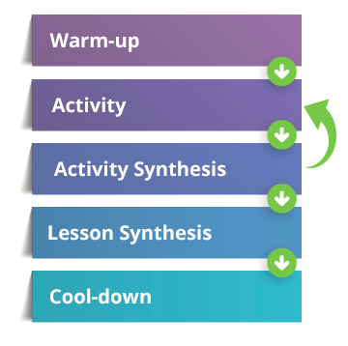
Open Up Resources (OUR) for Math 6, 6+, 7, 7+, 8
Structure of Each Lesson

Slide 12
Open Up Resources (OUR) for Math 6, 6+, 7, 7+, 8
Opportunities for Assessment
1. Pre-Unit Assessment
2. Embedded assessment in every lesson
a. Student discourse and look-fors in Activity Narratives
b. Cool-downs
3. Mid- and End-of-Unit Assessments
4. Culminating lesson

Slide 13
Open Up Resources (OUR) for Math 6, 6+, 7, 7+, 8
Resources for Parents and Students
Open Up Resources: im.openupresources.org/
WCPSS Math Resources: wake-ms-math.weebly.com/support-resources.html
WCPSS Math Pacing: wake-ms-math.weebly.com/curriculum-documents.html
Grade 6 Math HW Resources: bit.ly/G6MathHWResources
Grade 7 Math HW Resources: bit.ly/G7MathHWResources
Math 8 HW Resources: bit.ly/Math8HWResources
Khan Academy: Online Math Tutorials www.khanacademy.org/

Slide 14
MVP Resources for
Math I and Math II
What is the Mathematics Vision Project?
MVP is an open-source high school mathematics curriculum written by and for teachers. MVP was created to address the future needs of students competing in a global community.
http://www.mathematicsvisionproject.com/

Slide 15
MVP Resources for
Math I and Math II
What is MVP Math like?
The MVP classroom experience does not look like the traditional math classroom that students may have experienced in the past. In the MVP classroom, the teacher launches a deep mathematical task and allows students time to work with others on solving the task. Teachers facilitate students to explore, question, consider, discuss their ideas, and listen to the ideas of their classmates. Then the teacher brings the whole class back together to discuss different solution pathways and the math involved.

Slide 16
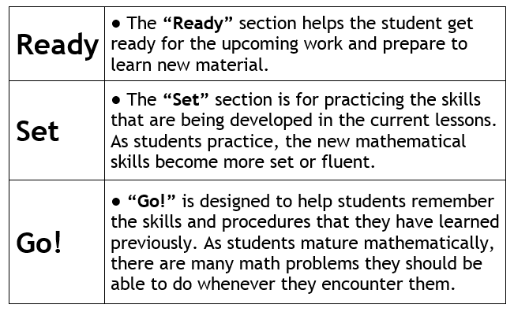
MVP Resources for
Math I and Math II
MVP Homework
The “Ready, Set, Go!” homework assignments are correlated to the daily classroom experience.

Slide 17
MVP Resources for
Math I and Math II
MVP Resources
Although the student materials can be accessed digitally thought the district’s Canvas site, students are provided with copies of a consumable workbook for each unit.

Slide 18
MVP Resources for
Math I and Math II
Parent and Student Support Resources
Math I and 2 MVP Homework Help
Canvas course “NC Math 1” or “NC Math 2”
WCPSS Math Resources: wake-ms-math.weebly.com/support-resources.html
WCPSS Math Pacing: wake-ms-math.weebly.com/curriculum-documents.html
Khan Academy: Online Math Tutorials www.khanacademy.org/

